Slide 1



MECE FOR CAPSTONE PROJECT ON RETAIL ANALYSIS
Maximizing Retail Sales: A Data-Driven Approach
The retail industry is fiercely competitive. To succeed, retailers must use data analytics to churn insights that will help them optimize sales strategies and increase customer loyalty.
by Aditya Swarnakar

Slide 2

Sales Analysis
1
Top-Selling Products
2
Sales Trends
Identification the products with the highest sales volume and revenue
Track sales patterns over time to identification seasonal trends or fluctuations
3
Most Profitable Products
Identification product lines that drive profitability and prioritize them for marketing and inventory management

Slide 3

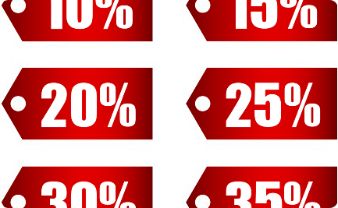

Product Analysis
Product Performance
Underperforming Products
Product Line Performance
Evaluat sales, quantity in stock, and profitability to make data-driven decisions
Identification of underperforming products and make necessary adjustments
Analyzing the performance of product lines to understand the categories that drive sales and profitability

Slide 4
Customer Analysis
1
Segmentation
Segmentation of customers based on their purchasing behavior, demographics, or geographic location to create targeted marketing campaigns
2
High-Value Customers
Identification of high-value customers and develop strategies to retain and upsell them
3
Preferences
Analyzing customer preferences to personalize marketing campaigns and improve customer experiences

Slide 5
Demographic Analysis
Understanding Customer Demographics
Targeted Marketing Campaigns
Evaluating Marketing Effectiveness
Understanding the distribution of customers across different demographics like age, gender, and location
Identification of target demographics for specific products or marketing campaigns
Evaluating the effectiveness of marketing efforts in reaching and engaging different demographic groups

Slide 6
Inventory Analysis
Optimizing Inventory Levels
Identification of Slow-Moving or Overstocked Products
Analyzation of product demand and sales patterns to optimize inventory levels
Taking appropriate actions such as offering promotions or adjusting procurement for slow-moving or overstocked products

Slide 7
Marketing Analysis
Evaluating Campaigns
Allocation of Resources
Tailored Messages
Evaluating the effectiveness of marketing campaigns by analyzing sales uplift and customer response
Identification of the most successful marketing channels and allocate resources accordingly
Using customer segmentation data to tailor marketing messages and offers to specific customer groups

Slide 8

Summary
By analyzing data on sales, customers, demographics, inventory, and marketing, retailers can gain insights into their performance and optimize their strategies accordingly. This leads to increased sales, profitability, and customer satisfaction.

